Slide 1
Unit NO 4 Cloud Applications

Slide 2
Scientific Applications

Slide 3
Topics to be Covered
Scientific Applications
Healthcare: ECG analysis in Cloud
Biology: Protein Structure Prediction,
Geoscience: Satellite Image Processing
Business and Consumer Applications :
CRM and ERP
Productivity
Social Networking
Media Applications
Multiplayer Online Gaming

Slide 4
Healthcare: ECG analysis in Cloud
Healthcare is a domain in which computer technology has found several and diverse applications:
from supporting the business functions to assisting scientists in developing solutions to cure diseases.

Slide 5
Healthcare: ECG analysis in Cloud
With recent technological developments such as cell phones and cloud computing, a range of services and devices are developed to provide health care.
In the cloud system, medical data can be gathered and distributed automatically to medical practitioners anywhere in the world.
From there, doctors in the field have the capability of returning input to specific patients.

Slide 6
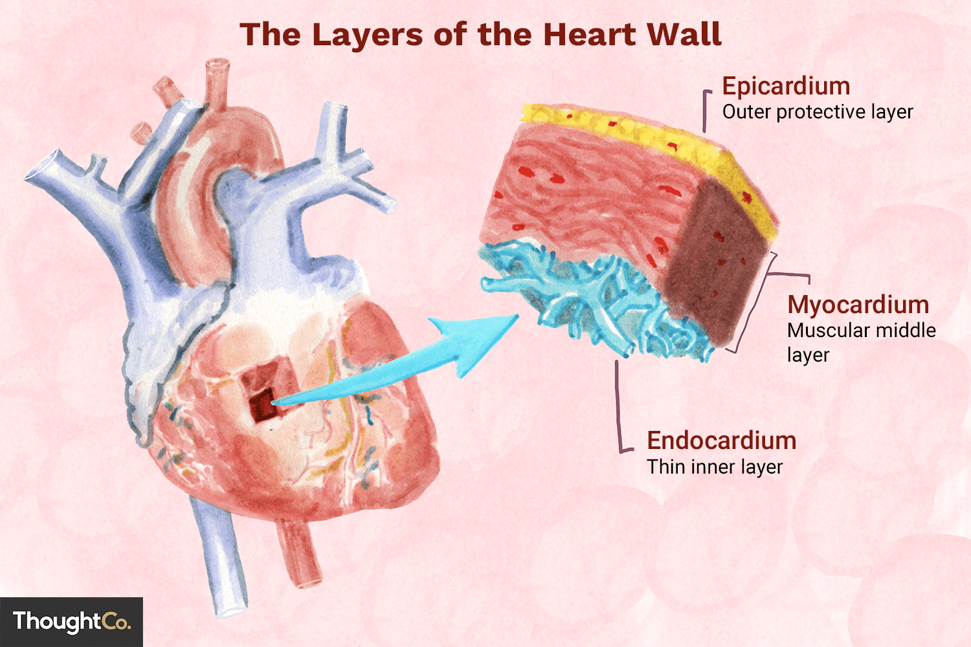
Healthcare: ECG analysis in Cloud
An E-G (electrocardiogram) is the electrical expression of the contractile movement of the heart’s myocardium.
Similarly, like other muscles, the heart contracts in response to electrical depolarization caused in the muscle cells.

Slide 7
Healthcare: ECG analysis in Cloud
An ECG is just a visual image of a record of the electrical activity of the heart muscle as it varies over time, typically printed on paper for easier study.

Slide 8
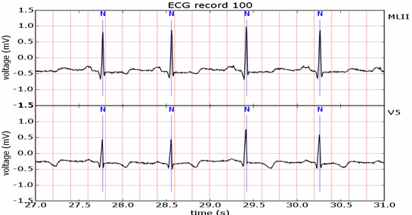
Healthcare: ECG analysis in Cloud
The full form of ECG is Electrocardiogram.

Slide 9
Healthcare: ECG analysis in Cloud
This activity produces a specific waveform that is repeated over time and that represents the heartbeat.

Slide 10
Healthcare: ECG analysis in Cloud
“Arrhythmias” means
“not having a steady rhythm”,
“an arrhythmic heartbeat”
a heart beat which is not in it’s rhythm.

Slide 11
Healthcare: ECG analysis in Cloud
Arrhythmia (commonly called irregular heartbeat)
is the name for a number of conditions, where the heartbeat is not normal.
It may be too fast (tachycardia);
too slow (bradycardia); or
the heart may not beat in its regular rhythm.

Slide 12
Healthcare: ECG analysis in Cloud
The analysis of the shape of the ECG waveform is used to identify arrhythmias and is the most common way to detect heart disease.
With ECG data collection and tracking, it's possible to test for chest pain, low-grade heart rhythm disturbances, arrhythmias, and more.

Slide 13
Healthcare: ECG analysis in Cloud
Cloud computing technologies allow the remote monitoring of a patient’s heartbeat data, data analysis in minimal time, and the notification to the first-aid personnel and doctors if the data reveal potentially dangerous conditions.
This way a patient at risk can be constantly monitored without going to a hospital for ECG analysis. At the same time, doctors and first-aid personnel can instantly be notified of cases that require their attention

Slide 14
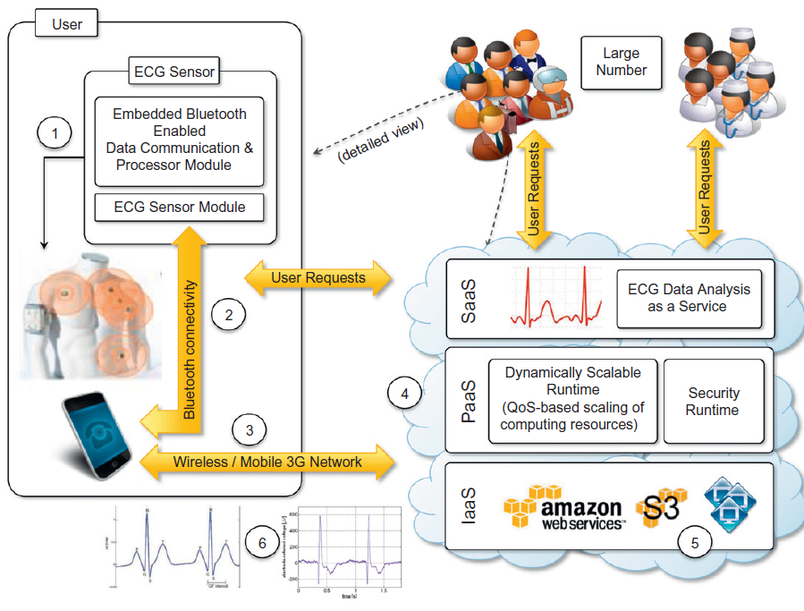
Healthcare: ECG analysis in Cloud

Slide 15
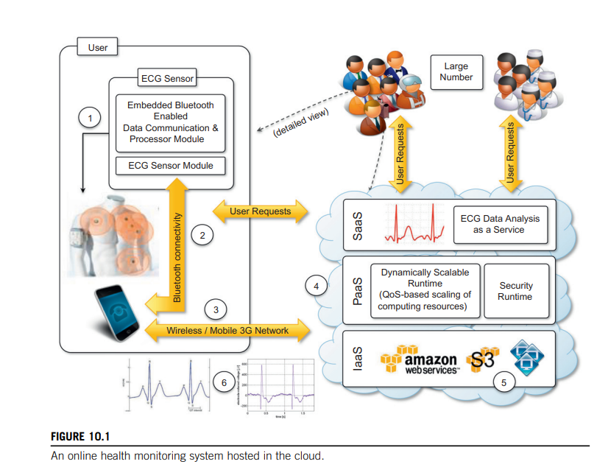
Healthcare: ECG analysis in Cloud
Wearable computing devices equipped with ECG sensors constantly monitor the patient’s heartbeat.
Such information is transmitted to the patient’s mobile device, which will eventually forward it to the cloud-hosted Web service for analysis.

Slide 16
Healthcare: ECG analysis in Cloud
The Web service forms the front-end of a platform that is entirely hosted in the cloud and that leverages the three layers of the cloud computing stack: SaaS, PaaS, and IaaS.
The Web service constitute the SaaS application that will store ECG data in the Amazon S3 service(IAAS)and issue a processing request to the scalable cloud platform.

Slide 17
Healthcare: ECG analysis in Cloud
The runtime platform is composed of a dynamically sizable number of instances running the workflow engine and Aneka.
Aneka controls the number of EC2 instances used to execute the single tasks defined by the workflow engine for a single ECG processing job.

Slide 18
Healthcare: ECG analysis in Cloud
Each of these jobs consists of a set of operations involving the extraction of the waveform from the heartbeat data and the comparison of the waveform with a reference waveform to detect anomalies.
If anomalies are found, doctors and first-aid personnel can be notified to act on a specific patient.

Slide 19
Advantages
As a consequence, the doctor doesn't need to put a huge effort into computing, since there is a lot of software on which to run.
The doctor's office would not need to invest in a broad computer system.

Slide 20
Advantages
The first advantage is the elasticity of the cloud infrastructure that can grow and shrink according to the requests served. As a result, doctors and hospitals do not have to invest in large computing infrastructures, thus making more effective use of budgets.
The second advantage is ubiquity. Cloud computing technologies have now become easily accessible from anywhere with minimum or no downtime. Computing systems hosted in the cloud are accessible from any Internet device through simple interfaces (such as SOAP and REST-based Web services).

Slide 21
Biology: Protein structure prediction
What is Protein ?
Proteins are large molecules consisting of amino acids which the cells in our bodies need to function properly.
Our body structures, functions, the regulation of the body’s cells, tissues and organs cannot exist without proteins.
Protein is found throughout the body—in muscle, bone, skin, hair, and virtually every other body part or tissue.
Protein accounts for 20% of total body Weight.

Slide 22
Biology: Protein structure prediction
What is Protein ?
Proteins are made up of hundreds or thousands of smaller units called amino acids, which are attached to one another in long chains.
There are 20 different types of amino acids that can be combined to make a protein. The sequence of amino acids determines each protein’s unique 3-dimensional structure and its specific function.

Slide 23
Biology: Protein structure prediction
Why do we need Protein ?
Your hair, your nails, and the outer layers of your skin are made of the protein keratin.
Keratin is a protein resistant to digestive enzymes.
So if you bite your nails, you can’t digest them.
Bone has plenty of protein.
The soft material inside the bone, also contains protein.
Red blood cells contain haemoglobin, a protein compound that carries oxygen throughout the body.
Finally, proteins play an important part in the creation of every new cell and every new individual.

Slide 24
Biology: Protein structure prediction
Why do we need Protein ?
Haemoglobin (haemoglobin, Hb or Hgb) is a protein containing iron that facilitates the transport of oxygen in red blood cells.
Almost all vertebrates contain haemoglobin, with the exception of the fish family Channichthyidae.[4]
Haemoglobin in the blood carries oxygen from the respiratory organs (lungs or gills) to the other tissues of the body

Slide 25
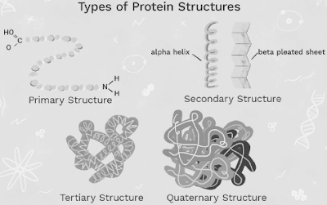
Types of Protein Structures

Slide 26
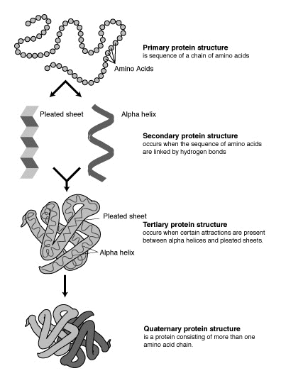
Types of Protein Structures

Slide 27
Types of Protein
Based on structure, we can divide protein into two types:
Primary Protein
Secondary Protein

Slide 28
Primary Protein
The linear sequence of amino acids within a protein is considered the protein’s primary structure.
Each protein has a distinctive primary structure that varies in the pattern amino acids are arranged and the total number of amino acids present in the protein molecule.
Haemoglobin is an example of a primary protein.

Slide 29
Secondary Protein
Secondary Protein is the three-dimensional form of local protein segments. It is primarily defined by hydrogen bonds between amino acids and carboxyl oxygen atoms.
Alpha-Helix and Beta-Pleated sheets are types of the secondary structure of the protein.

Slide 30
Alpha-Helix Protein
The most common type of secondary structure of a protein is the alpha-helix.
In the alpha-helix protein, a hydrogen bond is formed between the N−H group to the C=O group of the amino acid.

Slide 31
Beta-Pleated Sheets of Protein
The second essential type of secondary structure of a protein is the Beta-Pleated Sheets of Protein.
It consists of various beta strands linked by hydrogen bonds between adjacent strands. Three to ten amino acids are combined to create a beta-strand polypeptide.

Slide 32
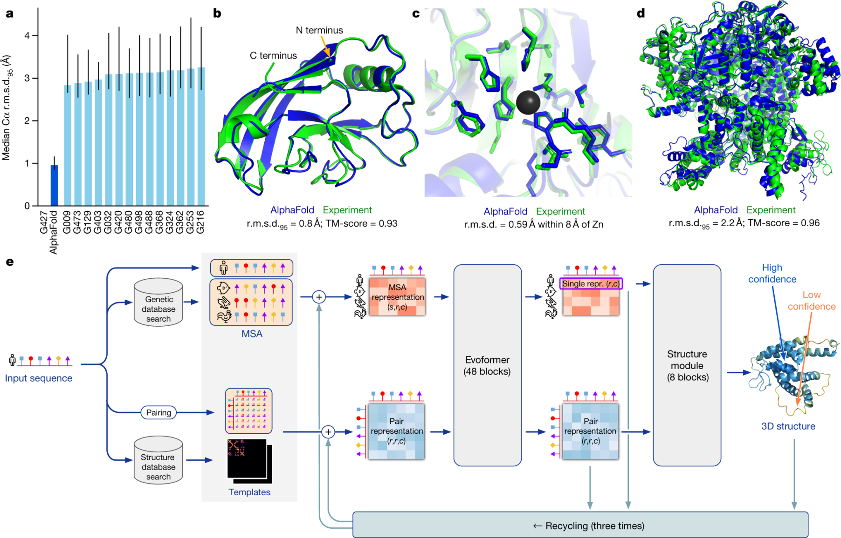
Protein Structure Prediction

Slide 33
Need Of Cloud Computing
The geometric structure of a protein cannot be directly inferred from the sequence of genes that compose its structure, but it is the result of complex computations aimed at identifying the structure that minimizes the required energy.
This task requires the investigation of a space with a massive number of states, consequently creating a large number of computations for each of these states

Slide 34
Need Of Cloud Computing
The computational power required for protein structure prediction can now be acquired on demand, without owning a cluster or navigating the bureaucracy to get access to parallel and distributed computing facilities.
Cloud computing grants access to such capacity on a pay-per-use basis

Slide 35
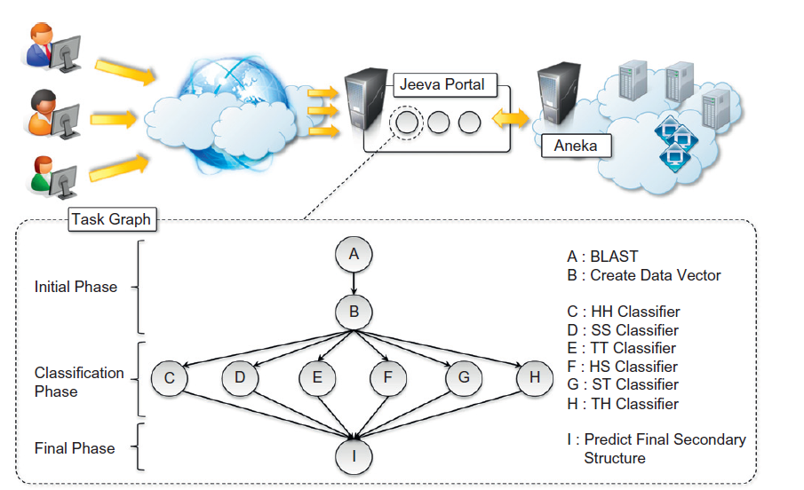
JEEVA Portal
A project that can analyze the use of cloud Technologies for protein structure prediction is JEEVA PORTAL.

Slide 36
Biology: Protein structure prediction
JEEVA PORTAL:
It is an integrated web portal that enables the scientists to do the prediction task using cloud techniques.
An integrated Web portal that enables scientists to offload the prediction task to a computing cloud based on Aneka

Slide 37
Biology: Protein structure prediction
JEEVA PORTAL:
This prediction Task uses machine learning techniques for determining the secondary structure of proteins.

Slide 38
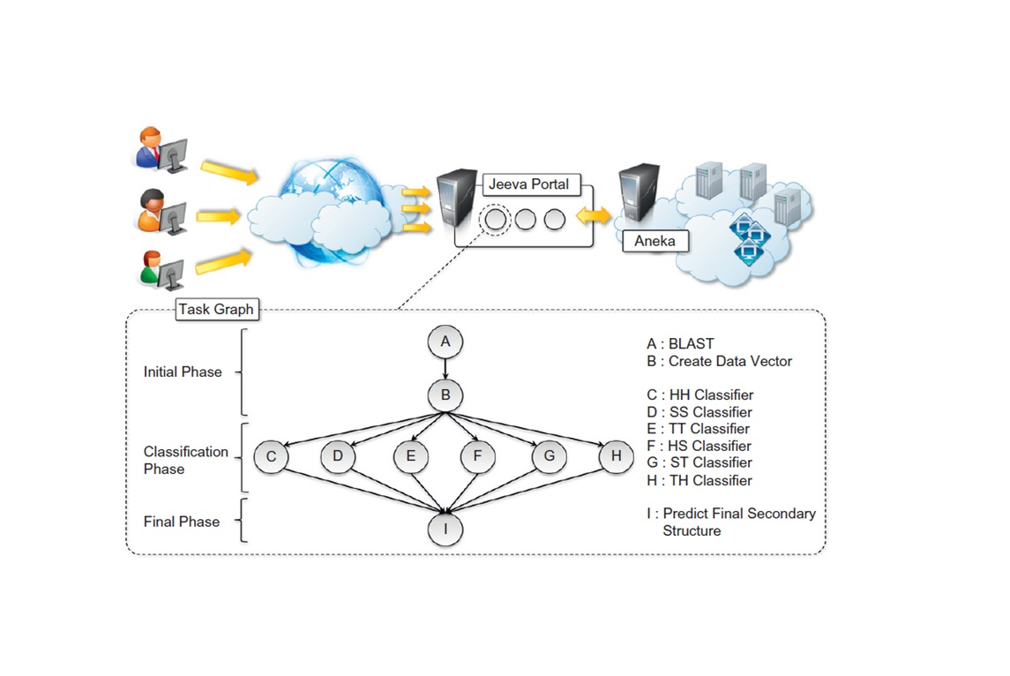
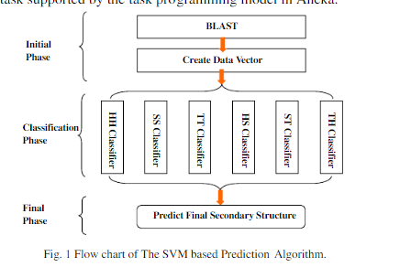
Biology: Protein structure prediction
JEEVA PORTAL:
A popular implementation based on support vector machines divides the pattern recognition problem into three phases:
initialization,
classification, and
a final phase.

Slide 39
Biology: Protein structure prediction
JEEVA PORTAL:
Even though these three phases have to be executed in sequence, it is possible to take advantage of parallel execution in the classification phase, where multiple classifiers are executed concurrently.

Slide 40
Biology: Protein structure prediction
JEEVA PORTAL:
Task Graph-
BLAST and Create Vector in the initial phase are represented by task A and B respectively.
Tasks C to H represent 6 classifiers in the classification phase,
Task I represents the final prediction phase.

Slide 41
Biology: Protein structure prediction
JEEVA PORTAL:
The classification phase is performed by six classifiers:
HH,
SS,
TT,
HS,
ST and
TH.
Generally, the prediction of secondary structure is a three class (H, E, C) pattern recognition problem.

Slide 42
Biology: Protein structure prediction
JEEVA PORTAL:
Each of the six classifiers will read the data vector from the initial phase and generate corresponding classification result.
Finally, the prediction result will be based on all of these six classification results in the final phase.

Slide 43
BLAST?
Basic local alignment search tool

Slide 44
BLAST?
In bioinformatics, BLAST (basic local alignment search tool)
An algorithm and program for comparing primary biological sequence information, such as the amino-acid sequences of proteins or the nucleotides of DNA and/or RNA sequences
A BLAST search enables a researcher to compare a subject protein or nucleotide sequence (called a query) with a library or database of sequences, and identify database sequences that resemble the query sequence above a certain threshold.

Slide 45
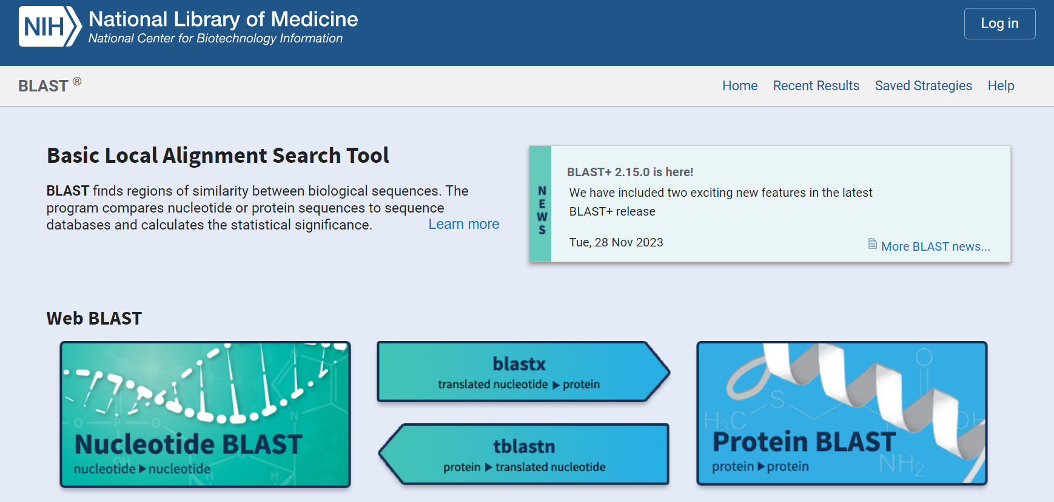
BLAST? https://blast.ncbi.nlm.nih.gov/Blast.cgi

Slide 46
BLAST?
For example, following the discovery of a previously unknown gene in the mouse,
A scientist will typically perform a BLAST search of the human genome to see if humans carry a similar gene;
BLAST will identify sequences in the human genome that resemble the mouse gene based on similarity of sequence.

Slide 47
PSI-BLAST?
Position-Specific Iterative Basic Local Alignment Search Tool
PSI-BLAST derives a position-specific scoring matrix (PSSM) or profile from the multiple sequence alignment of sequences detected above a given score threshold using protein–protein BLAST.

Slide 48
PSI-BLAST?
During the initial phase, the algorithm reads a protein sequence, submits it to PSI-BLAST to obtain the PSSM features and finally generates feature vector for classification.

Slide 49
Biology: Protein structure prediction
JEEVA PORTAL:
This creates the opportunity to sensibly reduce the computational time of the prediction.
The prediction algorithm is then translated into a task graph that is submitted to Aneka(scalable cloud middleware).
Once the task is completed, the middleware makes the results available for visualization through the portal.

Slide 50
Biology: Protein structure prediction
Aneka is a platform and a framework for developing distributed applications on the Cloud.
It harnesses the spare CPU cycles of a heterogeneous network of desktop PCs and servers or datacenters on demand.
Aneka provides developers with a rich set of APIs for transparently exploiting such resources and expressing the business logic of applications by using the preferred programming abstractions.

Slide 51
Geoscience: satellite image processing
Geoscience applications collect, produce, and analyze massive amounts of geospatial and non-spatial data.
As the technology progresses and our planet becomes more instrumented (i.e., through the deployment of sensors and satellites for monitoring), the volume of data that needs to be processed increases significantly.

Slide 52
Spatial and Non-Spatial Data
Spatial data provides the location information of the features whereas non-spatial data describes characteristics of the features.
Non-spatial data is also known as attribute data.
A combination of spatial and non-spatial data is known as geospatial data.

Slide 53
Spatial and Non-Spatial Data
It means that both (spatial and non-spatial) data are essential for successful operation of a GIS.
A typical GIS involves both spatial and non-spatial data.
The first principle you will learn here is that no GIS will work in the absence of non-spatial data.

Slide 54
What is Spatial Data?
Spatial data refers to information that has a geographic or spatial component. It represents the physical location, size, and shape of objects on the Earth’s surface.
Spatial data can be captured through various sources such as satellite imagery, GPS devices, aerial photographs, or surveys.
Examples of Spatial Data In GIS
We encounter spatial data in our everyday lives. Examples include:
Navigation maps like Google Maps.
Geolocation tags on social media posts.
Satellite images.

Slide 55
What is Non-Spatial Data?
Non-spatial data, in contrast, lacks any geographical components. This data represents the information that is independent of any spatial constraints.

Slide 56
Geoscience: satellite image processing
GIS applications capture, store, manipulate, analyze, manage, and present all types of geographically referenced data.
This type of information is now becoming increasingly relevant to a wide variety of application domains: from advanced farming to civil security and natural resources management.
As a result, a considerable amount of geo-referenced data is ingested into computer systems for further processing and analysis

Slide 57
Geoscience: satellite image processing
Satellite remote sensing generates hundreds of gigabytes of raw images that need to be further processed to become the basis of several different GIS products.
This process requires both I/O and compute-intensive tasks.
Large images need to be moved from a ground station’s local storage to compute facilities, where several transformations and corrections are applied. Cloud computing provides the appropriate infrastructure to support such application scenarios.

Slide 58
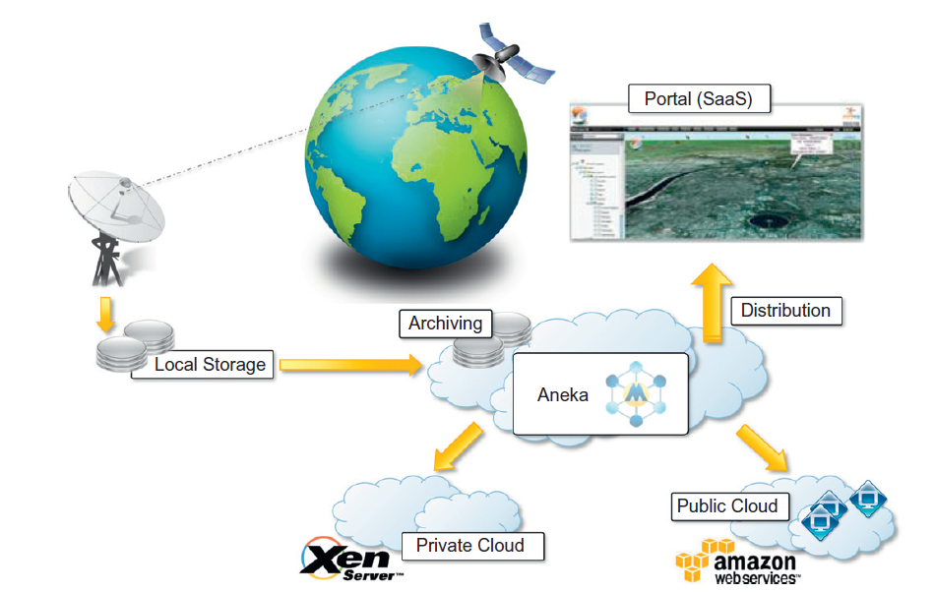

Slide 59
A cloud environment for satellite data processing.
A cloud-based implemen- tation of such a workflow has been developed by the Department of Space, Government of India

Slide 60
Geoscience: satellite image processing
A SaaS application provides a collection of services for such tasks as geocode generation and data visualization.
At the PaaS level, Aneka controls the importing of data into the virtualized infrastructure and the execution of image-processing tasks that produce the desired outcome from raw satellite images.
The platform leverages a Xen private cloud and the Aneka technology to dynamically provision the required resources (i.e., grow or shrink) on demand

Slide 61
Business and Consumer Applications

Slide 62
CRM and ERP
Productivity
Social Networking
Media Applications
Multiplayer Online Gaming

Slide 63
CRM
What is CRM?
CRM stands for Customer Relationship Management and is a software that is hosted in cloud so that the users can access the information using internet.
CRM can be easily moved to the cloud, thus the possibility of having access to your business and customer data from everywhere and from any device, has fostered the spread of cloud CRM applications
CRM software provides high level of security and scalability to its users and can be easily used on mobile phones to access the data.
Some of the major CRM vendors include Oracle Siebel, Mothernode CRM, Microsoft Dynamics CRM, Infor CRM, SAGE CRM, NetSuite CRM

Slide 64
CRM
What is CRM?

Slide 65
CRM
What is CRM?
CRM stands for “Customer Relationship Management” and is a software system that helps business owners easily track all communications and nurture relationships with their leads and clients.
A CRM consolidates all communications (form fills, calls, emails, text messages, and meetings), documents, quotes, purchases, and tasks associated with each lead and client. Your entire team can access those details at the right time–to close a sale or deliver outstanding service.

Slide 66
Cloud CRM
Advantages:
High reliability and scalability
Easy to use
Highly secured
Provides flexibility to users and service providers
Easily accessible

Slide 67
CRM
Top cloud-based CRM software that offer a wide range of benefits for businesses with different CRM software needs.
Salesforce: Best for improving sales functions
Microsoft Dynamics 365: Best for enterprise
HubSpot: Best for teams new to CRM
Oracle NetSuite: Best for e-commerce businesses
Zoho CRM: Best for remote and hybrid sales teams
Pipedrive: Best for visual sales pipeline tracking

Slide 68
Salesforce.com :CRM
Salesforce.com is probably the most popular and developed CRM solution available today.
As of today more than 100,000 customers have chosen Safesforce.com to implement their CRM solutions.
The application provides customizable CRM solutions that can be integrated with additional features developed by third parties.
Salesforce.com is based on the Force.com cloud development plat- form.
This represents scalable and high-performance middleware executing all the operations of all Salesforce.com applications.

Slide 69
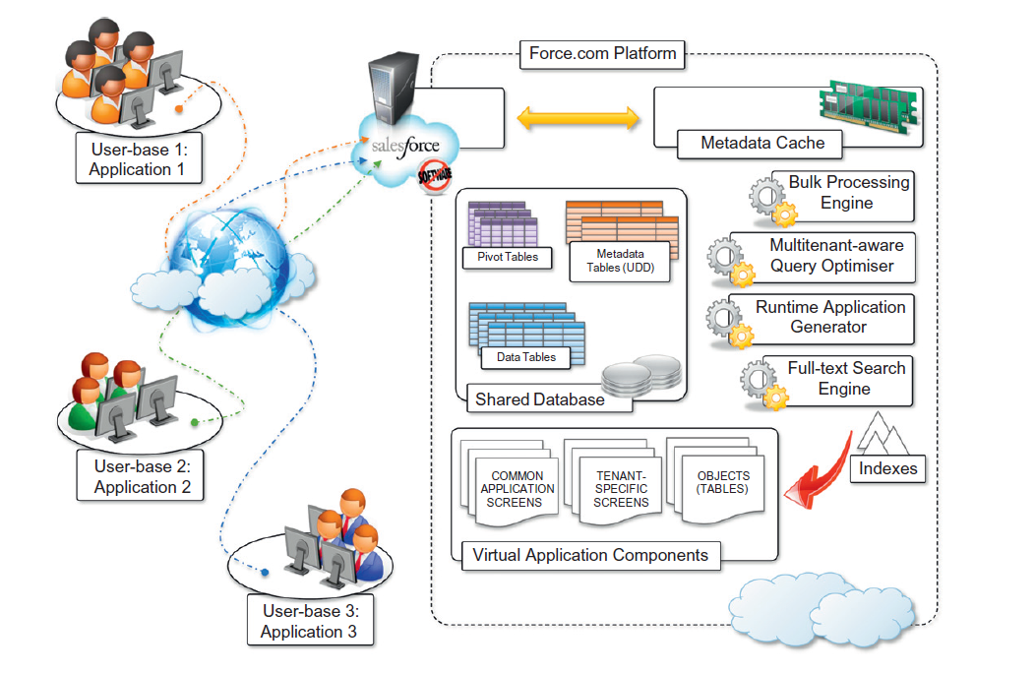
Architecture of Force.com

Slide 70
Architecture of Force.com
Application core logic and business rules are saved as metadata into the Force.com store.
A runtime engine executes application logic by retrieving its metadata and then performing the operations on the data.
Although running in isolated containers, different applications logically share the same database structure, and the runtime engine executes all of them uniformly.

Slide 71
Architecture of Force.com
A full-text search engine supports the runtime engine. This allows application users to have an effective user experience despite the large amounts of data that need to be crawled.
The search engine maintains its indexing data in a separate store and is constantly updated by background processes triggered by user interaction

Slide 72
ERP
What is ERP?
ERP is an abbreviation for Entity Resource Planning and is a software similar to CRM that is hosted on cloud servers which helps the enterprises to manage and manipulate their business data as per their needs and user requirements.
ERP systems integrate several aspects of an enterprise: finance and accounting, human resources, manufacturing, supply chain management, project management, and CRM.

Slide 73
ERP
What is ERP?
ERP software follows pay per use methodologies of payment, that is at the end of the month, the enterprise pay the amount as per the cloud resources utilized by them.
There are various ERP vendors available like Oracle, SAP, Epicor, SAGE, Microsoft Dynamics, Lawson Softwares and many more.

Slide 74
Traditional ERP software was typically out of reach for small to midsize businesses (SMBs) because it was expensive and difficult to implement.
Now cloud ERP software provides customer relationship management (CRM) and business intelligence (BI) features at an affordable price.

Slide 75
Cloud ERP software is an enterprise resource planning platform that’s hosted online, so there’s no need to install it on in-house servers, as is traditionally the case.
It’s meant to help businesses run all departments, from accounting and human resources (HR) to sales and manufacturing.

Slide 76
ERP
The Best 7 Cloud ERP Softwares
Microsoft Dynamics 365 Business Central: Best overall
SAP Business One Professional: Best for customization
SYSPRO: Best for manufacturing businesses
QT9: Best for real-time reporting
Epicor Prophet 21 ERP: Best for distributors
Oracle NetSuite OneWorld: Best for global companies
Acumatica: Best for easy pricing

Slide 77
ERP
Advantages:
Cost effective
High mobility
Increase in productivity
No security issues
Scalable and efficient

Slide 78
Productivity
Productivity applications replicate in the cloud some of the most common tasks that we are used to performing on our desktop:
from document storage to office automation and complete desktop environments hosted in the cloud

Slide 79
Dropbox and iCloud
One of the core features of cloud computing is availability anywhere, at any time, and from any Internet-connected device.
online storage solutions have turned into SaaS applications and become more usable as well as more advanced and accessible

Slide 80
Dropbox and iCloud
Dropbox, an online application that allows users to synchronize any file across any platform and any device in a seamless manner.
Dropbox is availabile on different platforms (Windows, Mac, Linux, and mobile) and the capability to work seamlessly and transparently across all of them

Slide 81
Dropbox and iCloud
Dropbox is a file hosting service operated by the American company Dropbox, Inc., headquartered in San Francisco, California, U.S.
that offers cloud storage, file synchronization, personal cloud, and client software.

Slide 82
Dropbox and iCloud
Dropbox was founded in 2007 by MIT students Drew Houston and Arash Ferdowsi as a startup company, with initial funding from seed accelerator Y Combinator.

Slide 83
Dropbox and iCloud
Dropbox brings files together in one central place by creating a special folder on the user's computer.
The contents of these folders are synchronized to Dropbox's servers and to other computers and devices where the user has installed Dropbox, keeping the same files up-to-date on all devices

Slide 84
Dropbox and iCloud
Dropbox provides users with a free amount of storage that is accessible through the abstraction of a folder.
Users can either access their Dropbox folder
through a browser or
by downloading and installing a Dropbox client, which provides access to the online storage by means of a special folder.

Slide 85
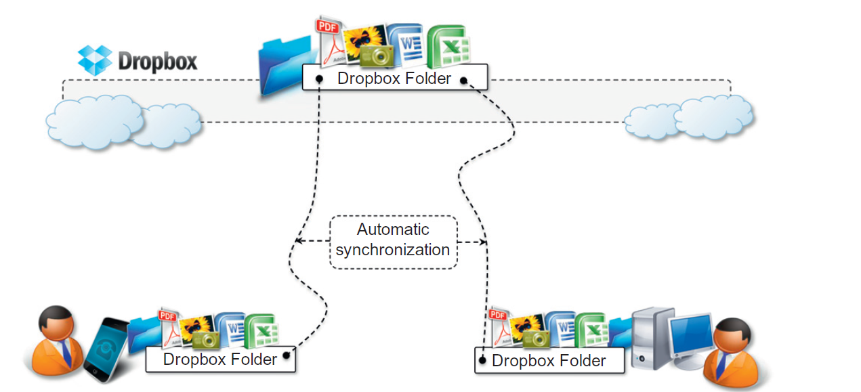
DropBox

Slide 86
iCloud
A cloud-based document-sharing application provided by Apple to synchronize iOS-based devices in a completely transparent manner
Documents, photos, and videos are automatically synched as changes are made, without any explicit operation.
There are other solutions for online document sharing,
WindowsLive
Amazon Cloud Drive
CloudMe.

Slide 87
iCloud
This allows the system to efficiently automate common operations without any human intervention:
Taking a picture with your iPhone and having it automatically available in iPhoto on your Mac at home;
Editing a document on the iMac at home and having the changes updated in your iPad.
Unfortunately, this capability is limited to iOS devices,

Slide 88
Other Application
Google Workspace
GoogleWorkspace is a SaaS application that delivers the basic office automation capabilities with support for collaborative editing over the Web
The application is executed on top of the Google distributed computing infrastructure, which allows the system to dynamically scale

Slide 89
Other Application
Google Workspace
Google Workspace is a cloud-based platform that allows users to create and edit documents (Google Docs), spreadsheets (Google Sheets), presentations (Google Slides), forms, and drawings. It is designed as an alternative to traditional desktop applications like Microsoft Office and OpenOffice, offering similar functionality with the added advantage of real-time collaboration and online access.
It supports collaborative editing over the Web for most of the applications included in the suite. This eliminates tedious emailing and synchronization tasks when documents need to be edited by multiple users

Slide 90
Other Application
Cloud desktops: EyeOS and XIOS/3

Slide 91
Other Application
EyeOs
One of the most popular Web desktop solutions based on cloud technologies.
It replicates the functionalities of a classic desktop environment and comes with pre-installed applications for the most common file and document management tasks
Single users can access the EyeOS desktop environment from anywhere and through any Internet-connected device, whereas organizations can create a private EyeOS Cloud on their premises to virtualize the desktop environment of their employees and centralize their management

Slide 92
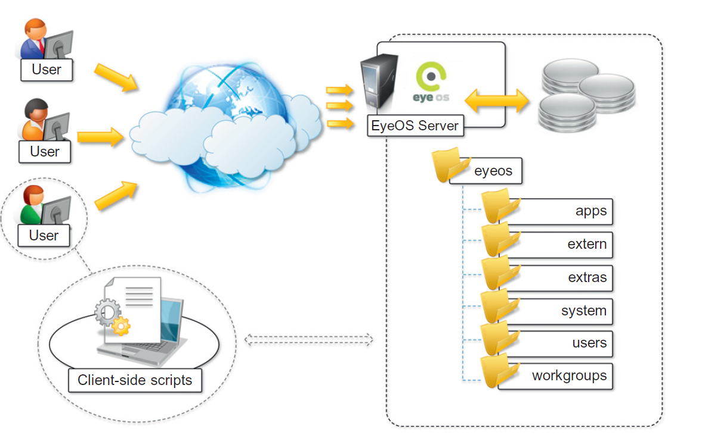
EyeOs

Slide 93
XIOS/3
is another example of a Web desktop environment .
The service is delivered as part of the CloudMe application, which is a solution for cloud document storage.
The key differentiator of XIOS/3 is its strong leverage of XML, used to implement many of the tasks of the OS:
rendering user interfaces
defining application business logics
structuring file system organization
even application development.

Slide 94
Social networking
Social networking applications have grown considerably in the last few years to become the most active sites on the Web.
To sustain their traffic and serve millions of users seamlessly, services such as Twitter and Facebook have leveraged cloud computing technologies.
The possibility of continuously adding capacity while systems are running is the most attractive feature for social networks, which constantly increase their user base

Slide 95
Social networking
Facebook
Whatsapp
Twitter
Instagram Etc.

Slide 96
Media applications
Media applications are a niche that has taken a considerable advantage from leveraging cloud computing technologies.
In particular, video-processing operations, such as encoding, transcoding, composition, and rendering, are good candidates for a cloud-based environment. These are computationally intensive tasks that can be easily offloaded to cloud computing infrastructures

Slide 97
Media applications
Animoto
The most popular example of media applications on the cloud.
The Website provides users with a very straightforward interface for quickly creating videos out of images, music, and video fragments submitted by users.
Users select a specific theme for a video, upload the photos and videos and order them in the sequence they want to appear, select the song for the music, and render the video

Slide 98
Animoto
The core value of Animoto is the ability to quickly create videos with stunning effects without user intervention.
A proprietary artificial intelligence (AI) engine, which selects the animation and transition effects according to pictures and music, drives the rendering operation.

Slide 99
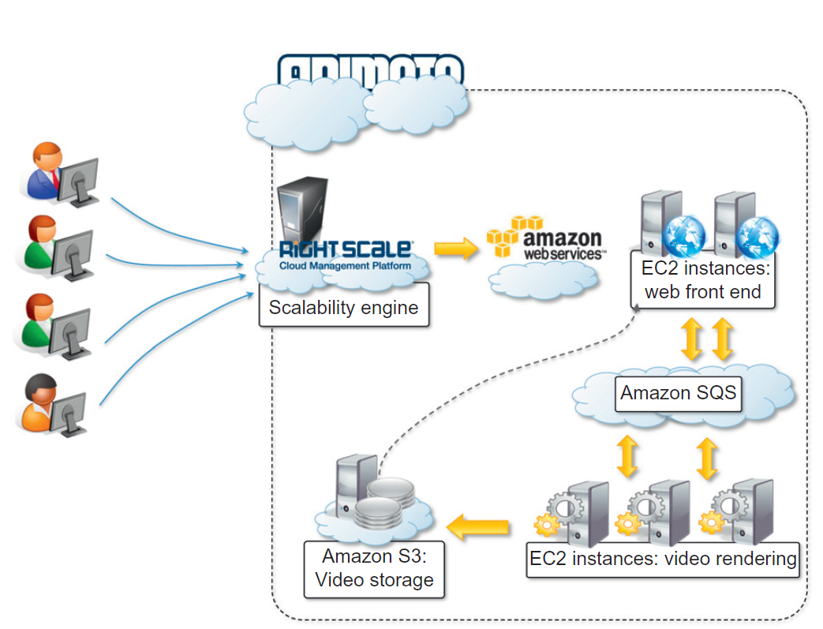
Animoto

Slide 100
Animoto
Implemented on top of the Amazon Web Services infrastructure.
Uses Amazon EC2 for the Web front-end and the worker nodes;
Amazon S3 for the storage of pictures, music, and videos; and
Amazon SQS for connecting all the components.
The system’s auto-scaling capabilities are managed by Rightscale, which monitors the load and controls the creation of new worker instances as well as their reclaim.

Slide 101
Animoto
Front-end nodes collect the components required to make the video and store them in S3.
Once the storyboard of the video is completed, a video-rendering request is entered into a SQS queue.
Worker nodes pick up rendering requests and perform the rendering.
When the process is completed, another message is entered into a different SQS queue and another request is served.

Slide 102
Animoto
This last queue is cleared routinely and users are notified about the completion.
The life of EC2 instances is controlled by Rightscale, which constantly monitors the load and the performance of the system and decides whether it is necessary to grow or shrink.

Slide 103
Maya
Autodesk Maya, commonly shortened to just Maya
A 3D computer graphics application that runs on Windows, macOS and Linux, originally developed by Alias and currently owned and developed by Autodesk.
It is used to create assets for interactive 3D applications (including video games), animated films, TV series, and visual effects.

Slide 104
Maya Rendering with aneka
Interesting applications of media processing are found in the engineering disciplines and the movie production industry.
A private cloud solution for rendering train designs has been implemented by the engineering department of GoFront group, a division of China Southern Railway.
The department is responsible for designing models of high-speed electric locomotives, metro cars, urban transportation vehicles, and motor trains.
The design process for prototypes requires high-quality, three-dimensional (3D) images.
The analysis of these images can help engineers identify problems and correct their design.

Slide 105
Maya Rendering with aneka
Three-dimensional rendering tasks take considerable amounts of time, especially in the case of huge numbers of frames, but it is critical for the department to reduce the time spent in these iterations.
This goal has been achieved by leveraging cloud computing technologies, which turned the network of desktops in the department into a desktop cloud managed by Aneka

Slide 106
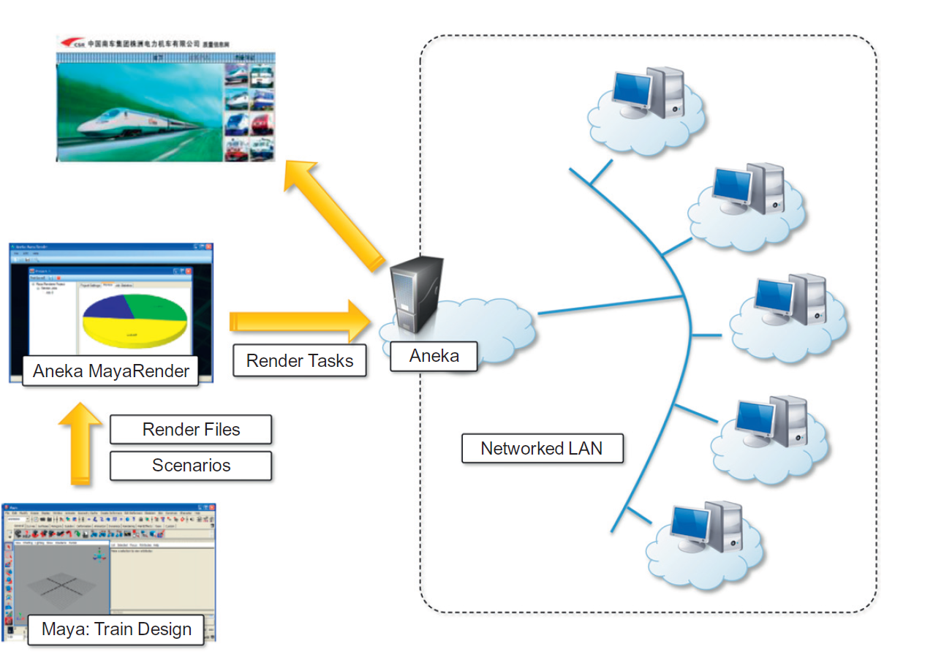
Maya Rendering with aneka

Slide 107
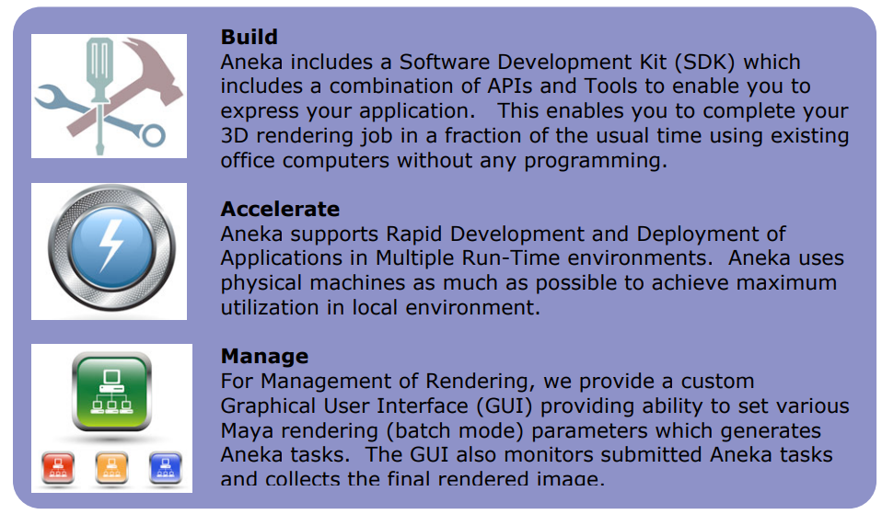
BUILD-
Aneka includes a Software Development Kit (SDK) which includes a combination of APIs and Tools to enable you to express your application.
This enables you to complete your 3D rendering job in a fraction of the usual time using existing office computers without having to do any programming.
For building solution to accelerate 3D rendering, you can use Aneka’s Design Explorer tool

Slide 108
ACCELERATE
Aneka supports Rapid Development and Deployment of Applications in Multiple Run-Time environments.
Aneka uses physical machines as much as possible to achieve maximum utilization in local environment.
As demand increases, Aneka provisions VMs via private clouds (Xen or VMWare) or Public Clouds (Amazon).

Slide 109
MANAGE
For Management of Rendering, we provide a custom Graphical User Interface (GUI) providing ability to set various Maya rendering (batch mode) parameters which generates Aneka tasks. The GUI also monitors submitted Aneka tasks and collects the final rendered image.

Slide 110
Multiplayer Online Gaming
Online multiplayer gaming attracts millions of gamers around the world who share a common experience by playing together in a virtual environment that extends beyond the boundaries of a normal LAN.
Online games support hundreds of players in the same session, made possible by the specific architecture used to forward interactions, which is based on game log processing.

Slide 111
Multiplayer Online Gaming
Players update the game server hosting the game session, and the server integrates all the updates into a log that is made available to all the players through a TCP port.
The client software used for the game connects to the log port and, by reading the log, updates the local user interface with the actions of other players.

Slide 112
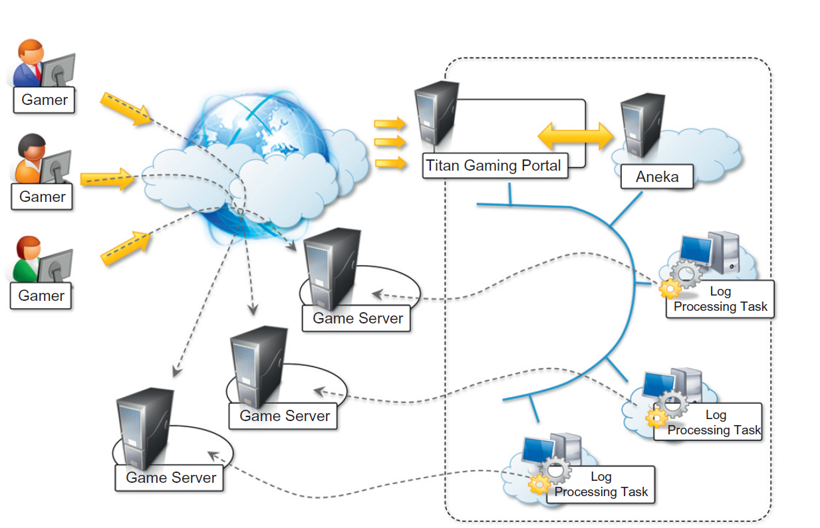
Multiplayer Online Gaming

Slide 113
Questions
Describe the key features of Google Apps .
What are Dropbox and iCloud? Which kinds of problems do they solve by using cloud technologies .
Describe some examples of CRM and ERP implementations based on cloud computing technologies .
What are the types of applications that can benefit from cloud computing?
What are the advantages cloud computing brings to the field of geoscience? Explain with an example .
What is the most important advantage of cloud technologies for social networking applications?
Provide some examples of media applications that use cloud technologies.
Describe an application of cloud technologies for online gaming.
Describe an application of cloud computing technology in the field of biology.
Describe how cloud computing technology can be applied to support remote ECG monitoring.

Slide 114
Flipped Classroom Activity 24.03.2026
Critically examine advanced cloud computing applications beyond classroom coverage across diverse domains, including Weather Forecasting and Climate Modeling, Disaster Prediction, Environmental Monitoring, Finance & Banking, E-Commerce & Retail , Government & Public Services, Transportation & Logistics, Artificial Intelligence, and Manufacturing.
Evaluate the role and key features of leading cloud platforms being used (Amazon Web Services/Microsoft Azure/Google Cloud) in enabling these applications

Slide 115
Flipped Classroom Activity 24.03.2026
Domains-
Weather Forecasting & Climate Modeling
Disaster Prediction (floods, earthquakes)
Environmental Monitoring
Finance & Banking
E-Commerce & Retail
Government & Public Services
Transportation & Logistics
Artificial Intelligence & Machine Learning
Manufacturing & Industry

